Slide 1
Computer Network Lab
IP Addressing
Lab 3

Slide 2
Addressing
what’s an address?
  identifier that differentiates between me and someone else, and also helps route data to/from me
real world examples of addressing?
  mailing address
  office #, floor, etc
  phone
1-<number>
Introduction

Slide 3
IPv4
An IP address is a numeric identifier assigned to each machine on an IP network. It designates the specific location of a device on the network.
IP addressing was designed to allow a host on one network to communicate with a host on a different network, regardless of the type of LANs the hosts are participating in.
IP address is a 32-bit value, that means that there are four billion different IP address possibilities.
Every IP address has two parts. These are known as the network number and the host number.

Slide 4
IP Terminology
Network address
  This is the designation used in routing to send packets to a remote network—
  for example, 10.0.0.0, 172.16.0.0, and 192.168.10.0.
Broadcast address
  The address used by applications and hosts to send information to all nodes on a network is called the broadcast address.
  Examples include 255.255.255.255, which is all networks, all nodes; 172.16.255.255, which is all subnets and hosts on network 172.16.0.0; and 10.255.255.255, which broadcasts to all subnets and hosts on network 10.0.0.0.

Slide 5
Network Addressing
The network address (which can also be called the network number) uniquely identifies each network.
Every machine on the same network shares that network address as part of its IP address.
In the IP address 172.16.30.56, for example, 172.16 is the network address.

Slide 6
Network Addressing
The designers of the Internet decided to create classes of networks based on network size.
For the small number of networks possessing a very large number of nodes, they created the rank Class A network.
At the other extreme is the Class C network, which is reserved for the numerous networks with a small number of nodes.
The class distinction for networks between very large and very small is predictably called the Class B network.

Slide 7
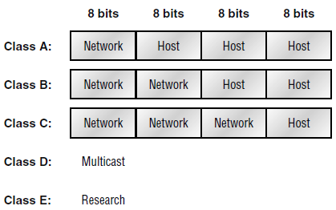

Slide 8
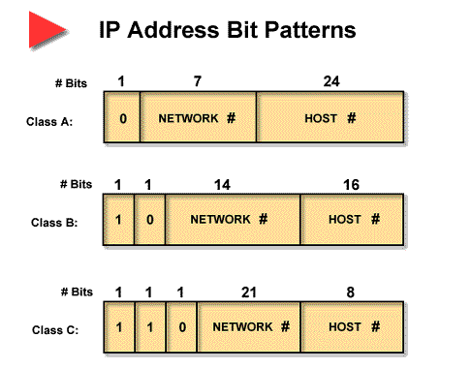
Number
of Networks
Number of Hosts
per Network
Range of
Network IDs
(First Octet)
Class A
126
16,777,214
1 – 126
Class B
16,384
65,534
128 – 191
Class C
2,097,152
254
192 – 223
1-<number>
Introduction

Slide 9
Network Address Range Class A
The first bit of the first octet in a Class A network address must always be off, or 0.
This means a Class A address must be between 0 and 127
If we turn the other 7 bits all off and then turn them all on, we’ll find the Class A range of network addresses
00000000 = 0
01111111= 127

Slide 10
Network Address Range Class B
First bit of the first octet must always be turned on, but the second bit must always be turned off.
If we turn the other 6 bits all off and then turn them all on, we’ll find the Class B range of network addresses
10000000 = 128
10111111 = 191

Slide 11
Network Address Range Class C
First 2 bits of the first octet as always turned on, but the third bit can never be on.
If we turn the other 5 bits all off and then turn them all on, we’ll find the Class C range of network addresses
11000000 = 192
11011111 = 223

Slide 12
Network Address Ranges:
Classes D and E
The addresses between 224 and 255 are reserved for Class D and E networks.
Class D (224–239) is used for multicast addresses.
Class E (240–255) for scientific purposes.

Slide 13
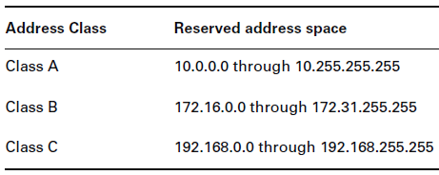
Private IP Addresses
Private IP Addresses are those that can be used on a private network, but they’re not routable through the Internet.

Slide 14
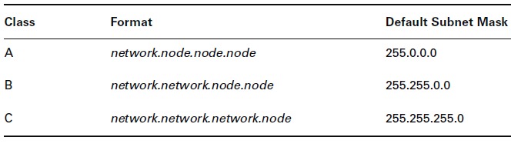
Subnet Masks
A subnet mask is a 32-bit value that allows the recipient of IP packets to distinguish the network ID portion of the IP address from the host ID portion of the IP address

Slide 15
Subnets
Subnetting is used to break the network into smaller more efficient subnets to prevent excessive rates of Ethernet packet collision in a large network
Subnetting hides the internal network organization to external routers and thus simplifies routing.
Subnetting allows address administration to be decentralized
For instance, an administrator could assi gn a subnet to a department, which would then be responsible for their own network management.
1-<number>
Introduction

